Slide 1
TAS152
LECTURE 17
TOPIC 3
TOWARDS A JUST INTERNET
3.1 INTRODUCTION + 3.2 THE NET AND ITS NEUTRALITY

Slide 2
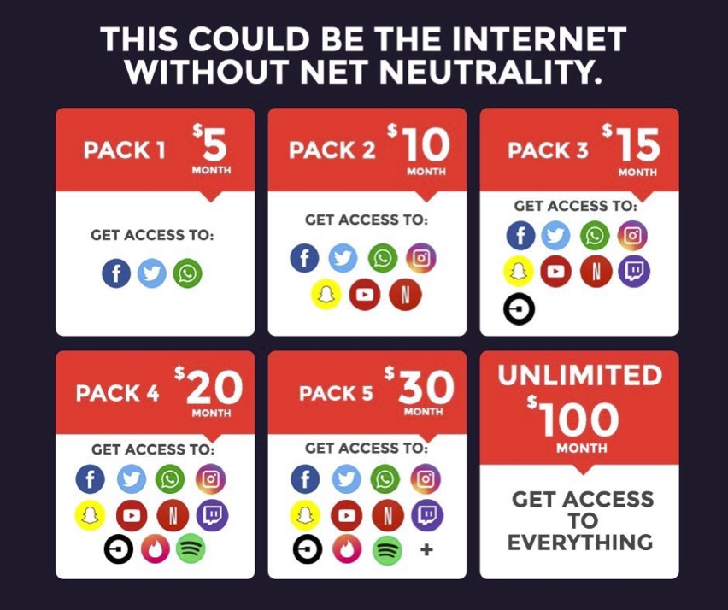
WHAT IS NET NEUTRALITY?
The term ‘Net neutrality’ refers to the concept of a free and just Internet.
This is a very generic concept, difficult to identify specific ethical challenges and values
The right of Internet users to access online content, applications, services and devices without discrimination
...issues of traffic management, individual freedom, informational ecosystems, and the elimination of domination between or within groups.

Slide 3
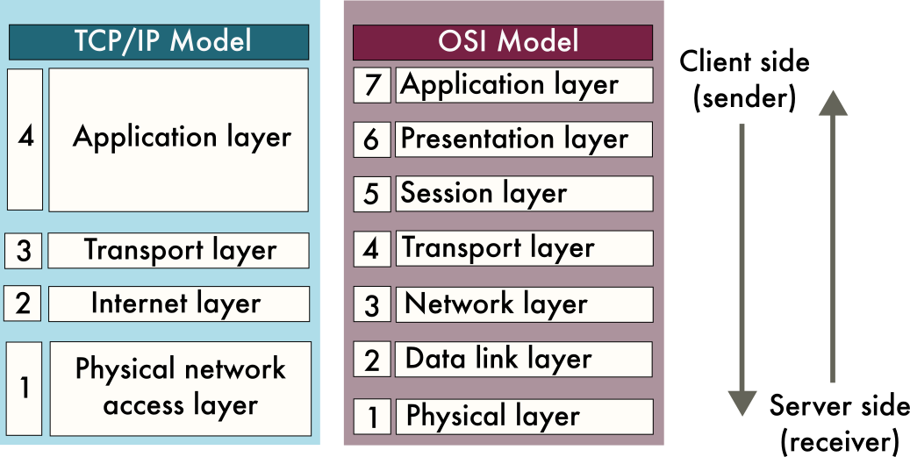
THE OSI MODEL
7 - This is where end-user applications and network services operate. It provides interfaces for users to interact with the network (e.g., web browsers, email clients).
6 - Transform the data before it can be used by the application layer. Encryption/decryption, encoding/decoding and compressing and decompressing data.
5 - Initiates and terminates communication between devices.
4 - Encompasses all aspects of communication between two devices, from start to finish (e.g., Transmission Control Protocol).
3 - Network layer facilitates data transfer between different networks (e.g., IP protocol).
2 - Facilitates data transfer between devices on the same network (e.g., Ethernet, Wi-Fi).
1- Infrastructure like switches, cables and other hardware that supports data transfer.

Slide 4
THE TCP/IP MODEL
4 - The application layer in TCP/IP model = layers 5, 6 and 7 in the OSI model.
3 - The transport layer in TCP/IP model corresponds with layer 4 from the OSI model.
2 - The internet layer from the TCP/IP model corresponds with layer 3 from the OSI model.
1 - The physical network/access layer from the TCP/IP model encompasses layers 1 and 2 from the OSI model.

Slide 5
HOW DO THE MODELS CORRESPOND WITH ONE ANOTHER

Slide 6
AT WHICH LAYERS IS NET NEUTRALITY APPLICABLE?
With regards to net-neutrality, we will define the structure of the Internet as comprising four main layers:
Net Neutrality Model
4 | End users
3 | Logical layer
2 | Service layer
1 | Physical infrastructure

Slide 7
AT WHICH LAYERS IS NET NEUTRALITY APPLICABLE?
Net Neutrality Model
4 | Occupied by end users who are recipients of the content that is stored and disseminated via the Internet.
3 | Logical layer focused on content providers, which are generally large organisations such as multimedia industries and news organisations.
2 | Service layer devoted to the delivery of usable services, which is generally the domain of software companies, developers and web architects
1 | Physical infrastructure of the network, which is generally maintained by large telecommunications corporations

Slide 8
MAPPING OF NET NEUTRALITY MODEL TO TCP/IP AND OSI MODELS
Net Neutrality Model
4 | End users
3 | Logical layer
2 | Service layer
1 | Physical infrastructure

Slide 9
MAPPING OF NET NEUTRALITY MODEL TO TCP/IP AND OSI MODELS
Net Neutrality Model
4 | End users
3 | Logical layer
2 | Service layer
1 | Physical infrastructure

Slide 10
MAPPING OF NET NEUTRALITY MODEL TO TCP/IP AND OSI MODELS
Net Neutrality Model
4 | End users
3 | Logical layer
2 | Service layer
1 | Physical infrastructure

Slide 11
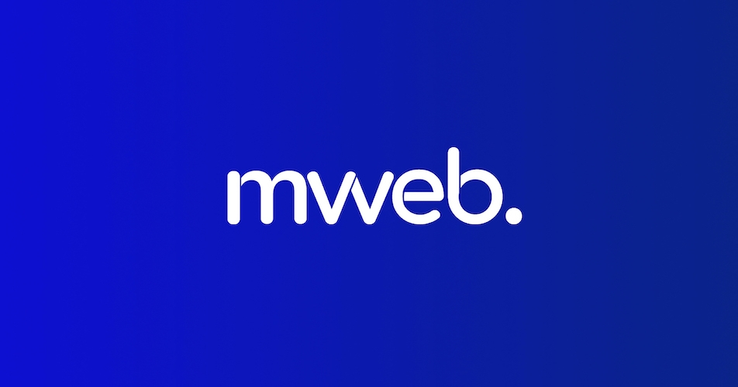





5 IAP (Internet Access Providers) CHALLENGES W.R.T. NET NEUTRALITY
Maintain network security/integrity and prevent attacks. IAPs share a common definition of ‘network security’ + what is a threat.
Alleviate traffic congestion by downgrading low-priority traffic. IAPs agree on fundamental services that are prioritised for provision of lower priority services.
Block access to illegal/copyrighted content. IAPs must distinguish between legal obligations and rules imposed by authoritarian regimes.
Provide a higher quality of service to specific users. IAPs charge different fees based on rapid response time or large data volumes.
Prioritise the IAPs own business to ensure ongoing sustainability. Favour own applications/services to undermine its competitors.

Slide 12
BALANCING COMPETING CHALLENGES
Balancing the competing demands in the previous slide is an ongoing challenge for IAPs.
Examples:
The fact that content has not been legally prohibited does not mean that it is ethically acceptable
Applications that are used for purposes such as video conferencing may legitimately require high levels of bandwidth.

Slide 13
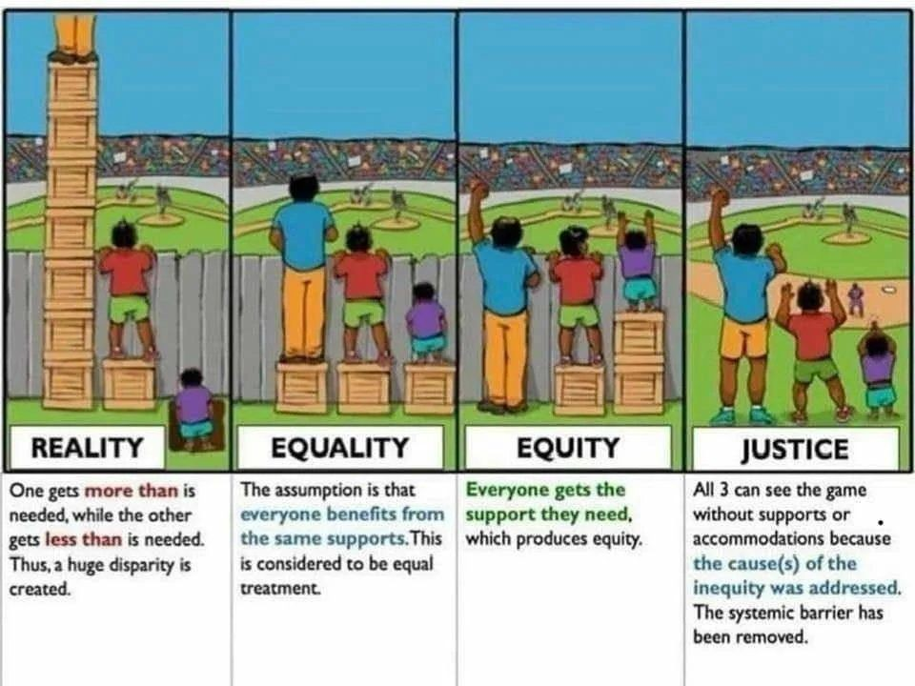
EQUALITY VERSUS EQUITY
Net neutrality relates to the broader concept of equity and equality.
A neutral (equality) distribution of goods and services does not necessarily equate to a just (equity) distribution of those goods and services.
Equity is more closely related with fairness, whereas equality is a measure of sameness.

